Slide 1
Kandis Lamke
Ruben Garcia
April 3, 2020

Slide 2
Agenda
Introductions
Industry Insights
Overview
Topic chosen
Key Objectives
Used technologies & Method
R programming
Python programming
Project Results
Analysis
Key findings
Conclusions
Next steps
Q&A
Notes:
Outline Agenda

Slide 3
introductions

Slide 4
Professional profile
Professional Experience
Chief Operating Officer
Controller
Accounting Manager
Entrepreneur
Education
Bachelor of Arts – Accounting Major
Licensed CPA
Kandis
Lamke

Slide 5
Professional profile
Professional Experience
OpEx programs implementation across Global Operations
Lean transformation throughout the Supply Chain
Centers of Excellence implementation
Lead Supplier Development programs
Education
MBA – Global Management
BS – Industrial Engineering
Lean Six Sigma Black Belt
Certified OCM professional
Certified SCM professional
Ruben
Garcia

Slide 6
Industry insights

Slide 7


overview
Industry:
PEO - Professional Employer Organization
Definitions:
WSE – Worksite Employee. Employees under the co-employment agreement that are supported by the payroll and human resources functions of the PEO.
Internal EE – Internal employees of the PEO that support clients and employees under the co-employment agreement.
Notes:
Project Summary – Domain Knowledge and Insight into the PEO Industry and standard benchmarks, etc

Slide 8
overview
PEOs provide access to cost-effective training and development
50% of business using PEOs are less likely to fail
30% time relieved by SMB leadership due to administrative and transactional issues
68% PEOs saw somewhat or significant revenue increase
35% PEOs saw a significant increase in WS_EE per client
56% PEOs saw somewhat or significant gross profit increase
28% PEOs saw somewhat or significant INT_EE (including Sales) increase
48% PEOs saw somewhat or significant Clients increase
85% PEOs see somewhat or significant WSEs change over the next 12 months
Notes:
Languages and methods used in the analysis

Slide 9
Project objectives
Define GP_WS_EE performance vs benchmarking
Identify improvement opportunities
Define WS_INT_EE_Ratio_S performance vs benchmarking
Identify improvement opportunities
Define a statistical model to predict number of INT_EE needed by Department to reach GP or WS_EE goals
Predict when the Company will reach GP or WS_EE goals based on prior year growth trend
Notes:
Languages and methods used in the analysis

Slide 10
Used technologies
and method

Slide 11
R – programming
Notes:
Languages and methods used in the analysis

Slide 12

Python – programming
Notes:
Languages and methods used in the analysis

Slide 13
Project results

Slide 14
analysis

Slide 15
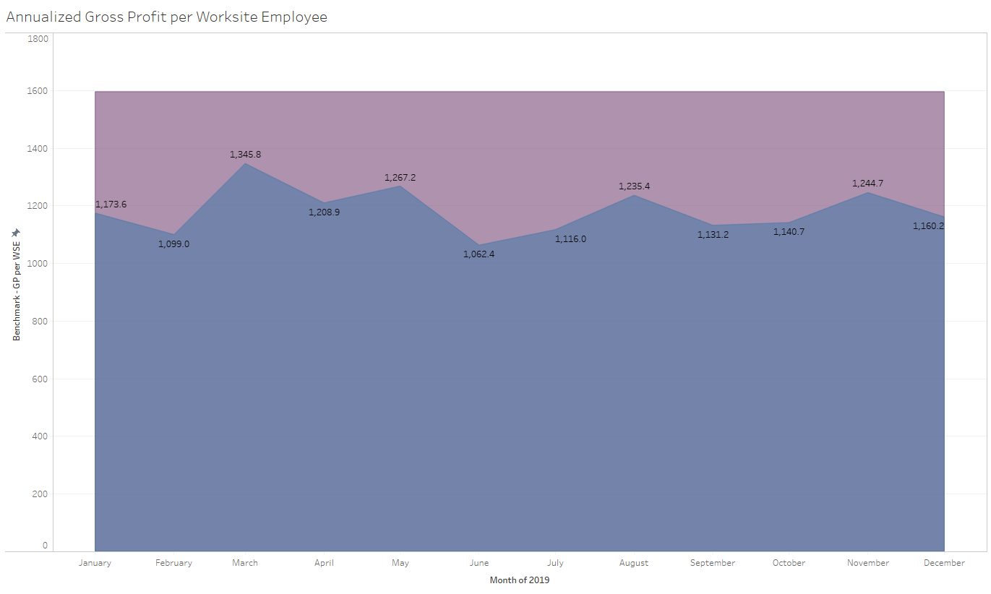
Project results

Slide 16

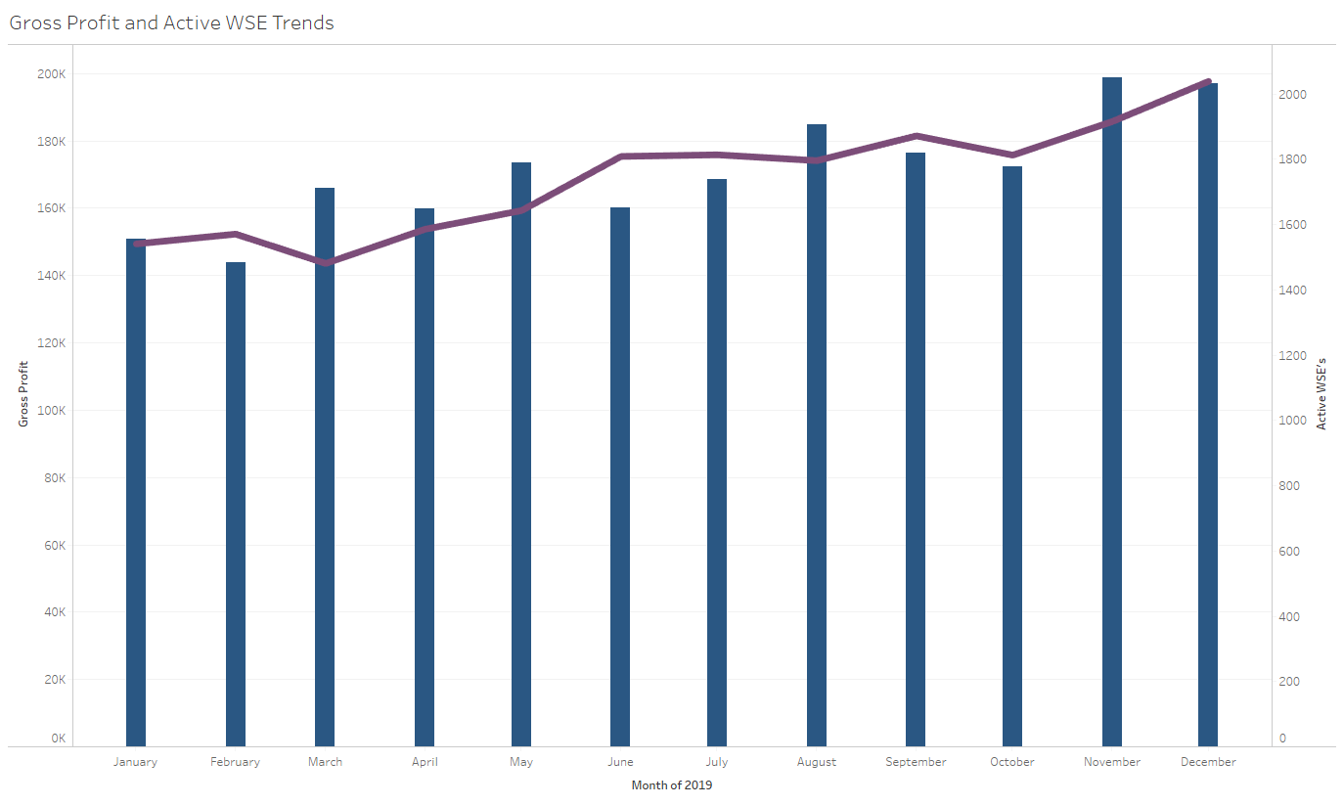
Project results

Slide 17
analysis

Slide 18
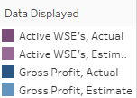
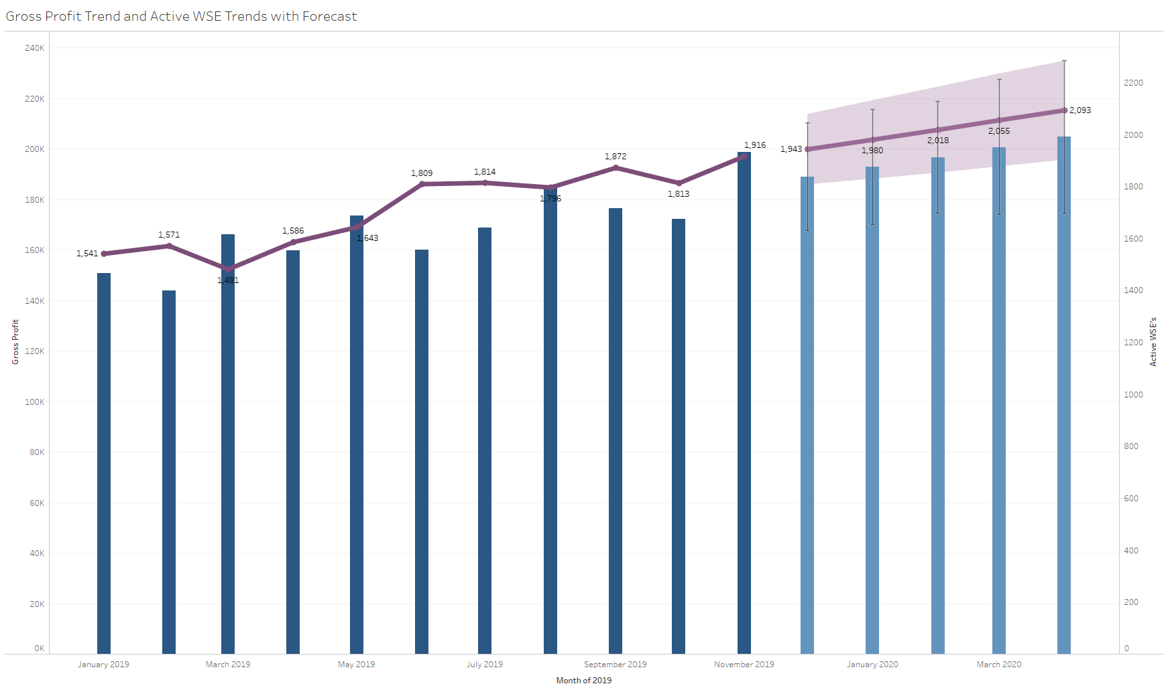
Project results

Slide 19

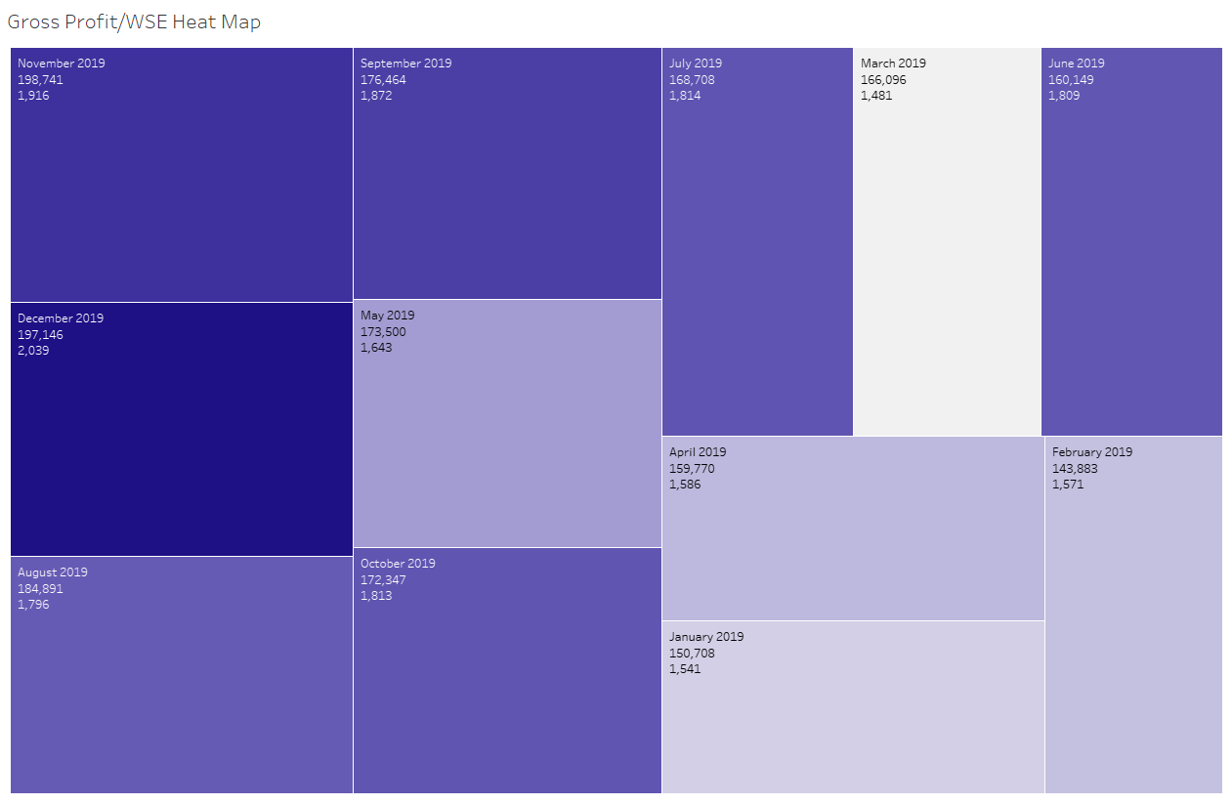
Project results

Slide 20
analysis

Slide 21
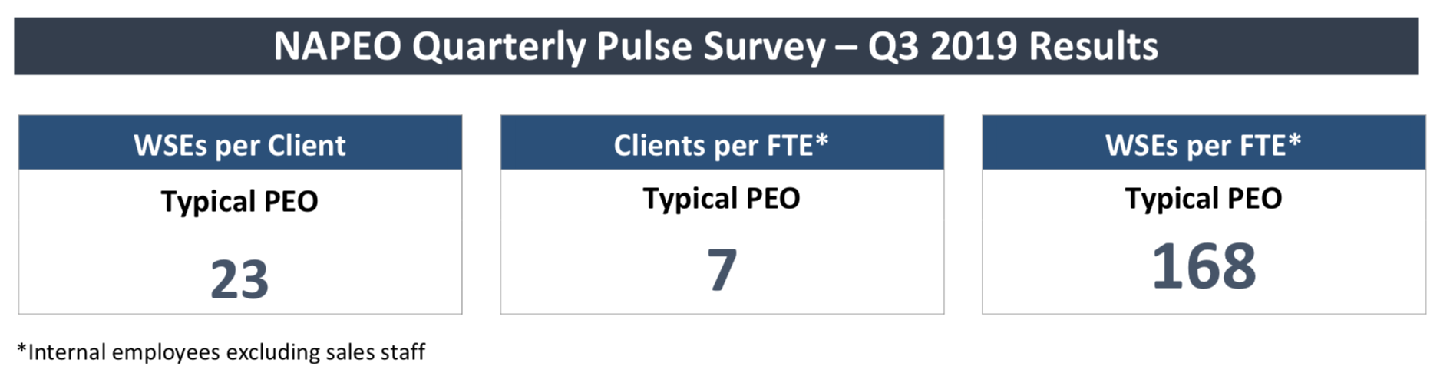
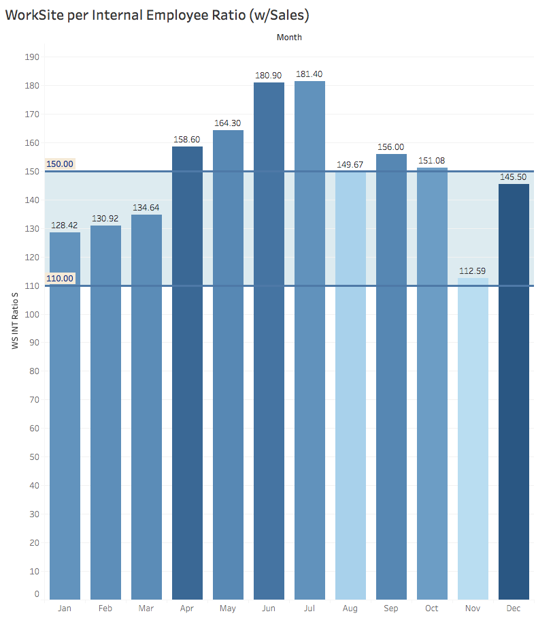
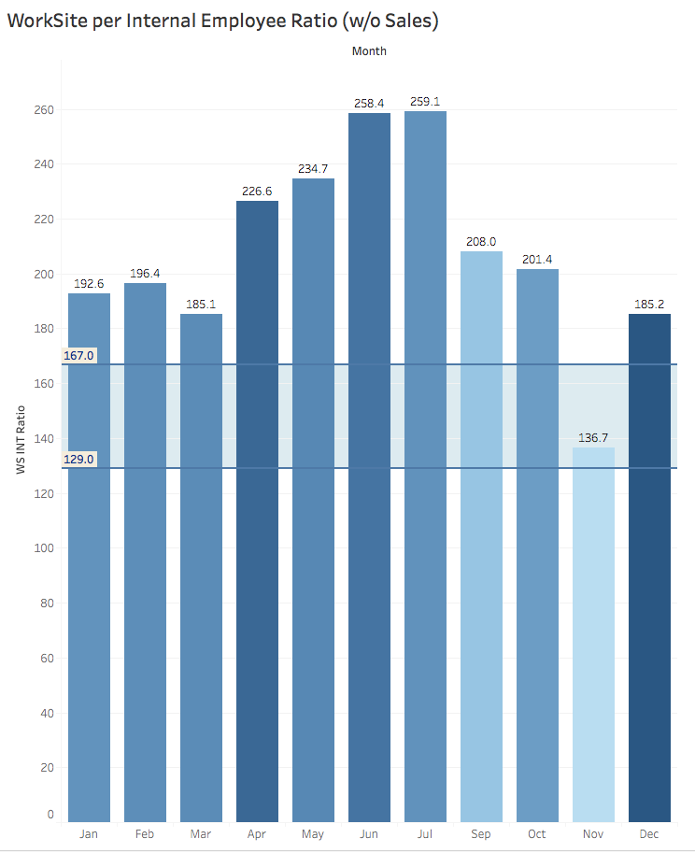
Project results

Slide 22
analysis

Slide 23
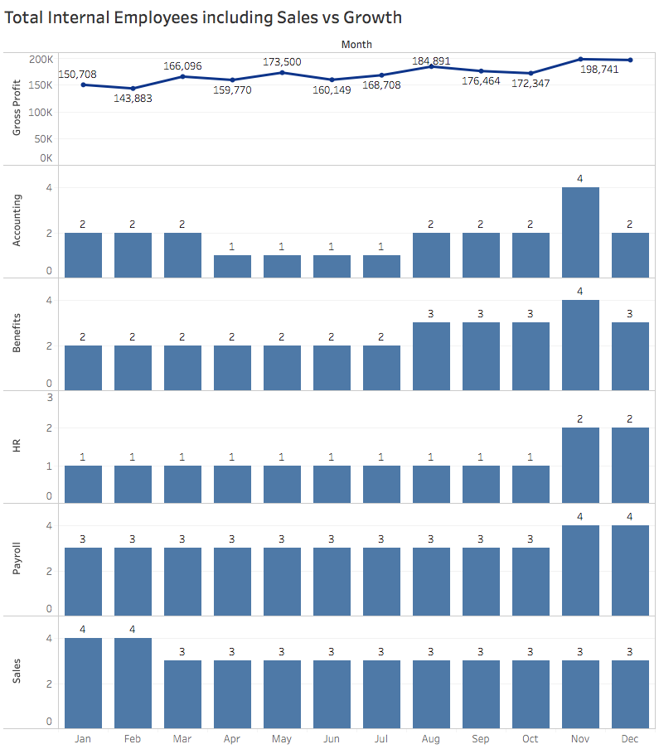
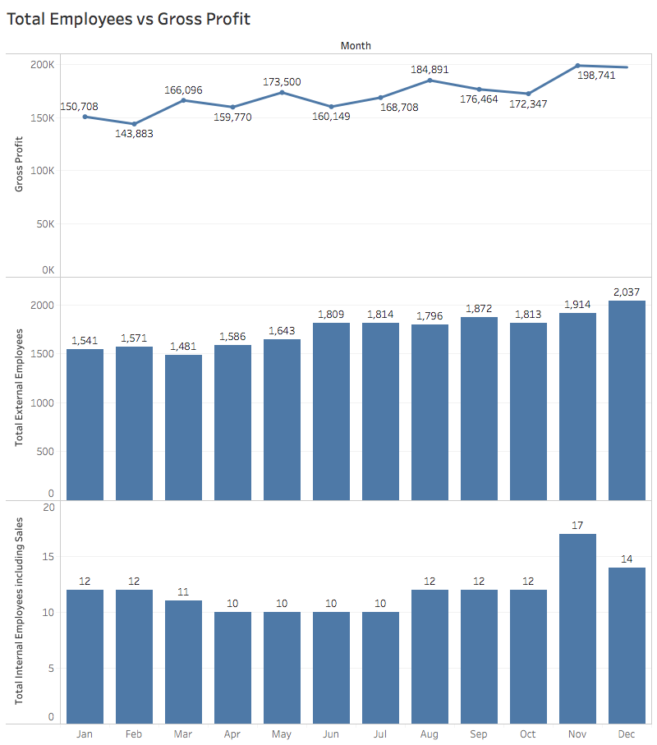
Project results

Slide 24
summary
WS_INT_Ratio_S performance
36% better than benchmark companies 150 vs 110
WS_INT_Ratio performance
60% better than benchmark companies 207 vs 129

Slide 25
conclusions

Slide 26
Conclusions

Slide 27
Next steps

Slide 28
next steps

Slide 29
QUESTIONS?

Slide 30
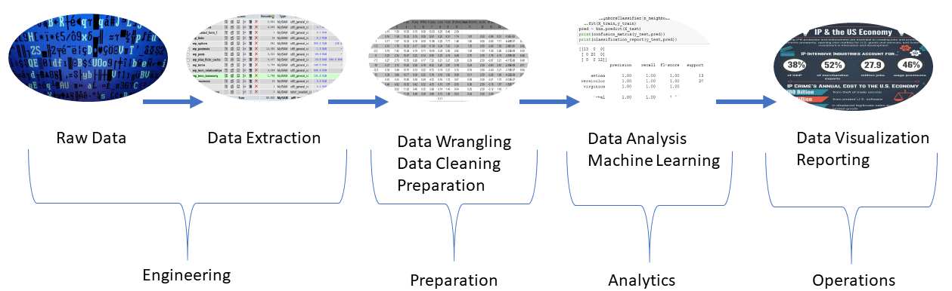
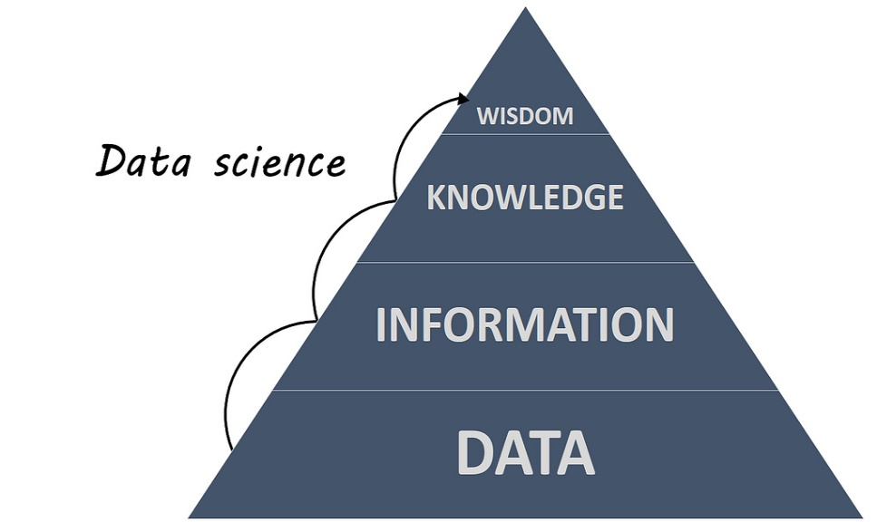






Slide 31



Executive summary

